Slide 1

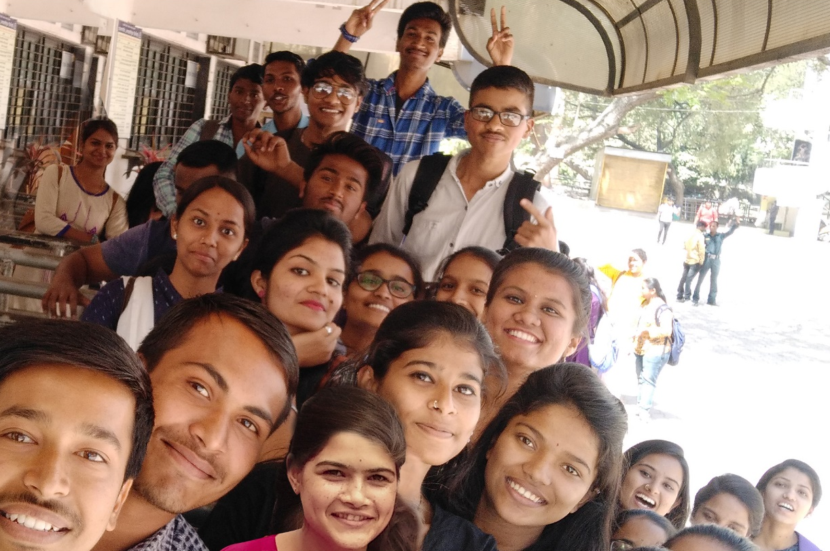
Youth Employment Program
Empowering People & Communities
Corporate Social Responsibility

Slide 2








Youth Employment Program
35
132K
30K+
108
6K
403
Mentor
States & UTs
Candidates Trained
Candidates Placed
PWD Trained
Dalits & Tribal Placed
Entrepreneurs
Teach
One to one mentoring by industry professionals / TCSers for job readiness to enter world of work
584
18K
Business skills, 21st century technical skills, digital skills, domain exposure facilitated by TCS SMEs and Freelance Trainers.
350+
72
61%
57.6%
Districts
Active Partners
Active Trainers
Women Trained
Women Placed
AA Trained in last 3 FYs
Place
Coach
Employment, Entrepreneurship, and pursuing higher Education as Career options
AA Meter 57.67%
Started 2010
Across India
Market Facing Certifications, Periodic Trainee Performance Evaluations, Leadership Connects, Domain Specific Trainings
Vision
Mission
To skill youth on skills required to be successful in digital age and connect them to the right opportunities
Youth from socially and economically marginalized communities are gainfully employed
Impact of the Program
Target Audience
Industry gets season agnostic talent pool
6% lesser attrition than industry
High performing freshers against other sources
Zero cost in recruitment or sourcing
Impact sourcing – impacting lives and livelihood of underprivileged
Impact on SDGs – reduction in poverty, better employment, gender parity, standard of living
18- to 25-year-old youth
Final year and passed out graduates
Dalit, Tribal, Women, PWD, low-income families
Rural India – in partnership with colleges, government bodies, NGOs and others
Notes:
Slide Updated

Slide 3













Youth Employment Program – What do we TEACH?
Offerings
Business
Communication Skills
Free training to enhance technical competencies and communication skills
Free certification on digital skills in partnership with Cisco and Google
Mentoring & Coaching for employment and entrepreneurship
Leadership connect and emerging/ cutting edge technology sessions
Faculty Development Programs
Employment assistance
Numerical Ability
Training
Modules
Technical Skills / Domain Skills/ New Age Technologies
Reasoning Ability
Assessments – Periodic Evaluations
Self Learning Interventions
Platforms Enabled
TCS iON
Coursera
Pre Verbal Competency Check: Analyses the comm skills before training
Pre Assessment: Analyses the existing competencies
Post Assessment: Analyses the competencies developed
Domain Specific Quizzes: To check Knowledge Transfer
Post Verbal Competency Check: Analyses the comm skills after training
Cisco Netacad
Notes:
Slide Updated

Slide 4
Course Catalogue
Learning Tracks | General (BA, B.Sc, B.Com, BBA, BBM, Pharma) | Smart (B.Sc IT/CS, BCA) | Tech (BE, B.Tech,MCA)
Mandatory | Business Communication Skills | Business Communication Skills | Business Communication Skills
 | Maths | Maths | Maths
 | Logical Reasoning | Logical Reasoning | Logical Reasoning
 | MS Office | Programming | Programming
 | Career guidance | Career guidance | Career guidance
Certification course (At least 1) | TCS iON Career Edge: Young Professional Course | TCS iON Career Edge: Young Professional Course | Cisco Netacad - Programming Essential - Python
 |  | Cisco Netacad - Programming Essential - Python
 | TCS iON: Accounting Fundamentals | Cisco Netacad - Network Essential | Cisco Netacad - Network Essential
 | Google - Data Analytics Professional Certificate | Cisco Netacad - Cyber Security Essential | Cisco Netacad - Cyber Security Essential
 | Google UX Design Professional Certificate | Google - Data Analytics Professional Certificate | Google - Data Analytics Professional Certificate
 |  | Google - UX Design Professional Certificate | Google - UX Design Professional Certificate
 | Google IT Support Professional Certificate | Google - IT Support Professional Certificate | Google - IT Support Professional Certificate
 |  | Google - IT Automation with Python Professional Certificate | Google - IT Automation with Python Professional Certificate
Optional courses | TCS iON Communication Skills | IBM Skill Build -Cloud Computing | IBM Skill Build -Cloud Computing
 | TCS iON Interview Skills | IBM Skill Build - Data Analytics | IBM Skill Build - Data Analytics
 | Cisco Netacad - Entrepreneurship | IBM Skill Build - Project Management | IBM Skill Build - Project Management

Slide 5



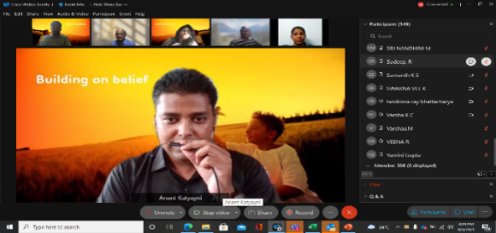

Youth Employment Program – How do we TEACH?
Engineering
Non-Engineering
Training Duration: 164 hours
Mode of Training: Physical, Digital, Phygital
Sessions Conducted by : TCS SME Volunteers
Faculty Development Programs on Cutting
Edge Technologies
Training Duration: 100 hours
Mode of Training: Physical, Digital, Phygital
Sessions Conducted by : Freelance Trainers
Robust Trainer Selection Process designed
in collaboration with Talent Development
Team
Notes:
Slide Updated

Slide 6





Youth Employment Program – How do we COACH?
Expert Talks Series
Leadership Connects
Domain Trainings through TCS SMEs & Industry Experts
Coaching to acquire industry recognized certifications
It is a very good opportunity to get myself certified from Cisco at free of cost. I am a mechanical student and the courses on programming skills are helping me a lot to improve my skills
says one of the student beneficiaries from Chaitanya Bharathi Institute of Technology (CBIT Proddatur, Andhra Pradesh).
Notes:
Slide Updated

Slide 7






Youth Employment Program – How do we PLACE?
Every candidate gets an opportunity to pursue her/his career. The opportunities available to the YEP beneficiaries presently are pursuing one of the three pathways as given below:
In TCS
Entrepreneurship
“
Pathways after completion of training
Employment
It has changed my life. I am the First person in my family to work in big MNC
Nilam,
YEP beneficiary from Village Dagpimpalgaon Taluka Vaijapur District Aurangabad, Maharashtra
Education (Pursue Higher Education)
Other Companies
Notes:
Slide Updated

Slide 8
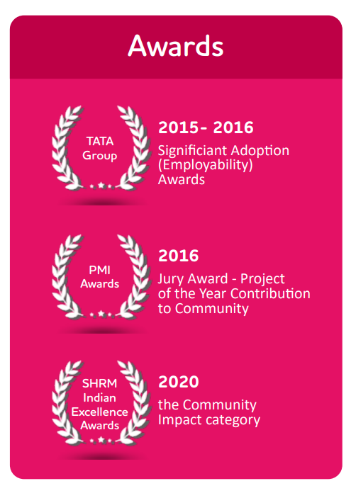
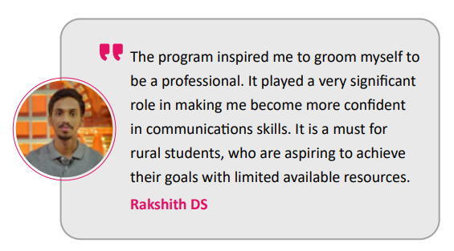
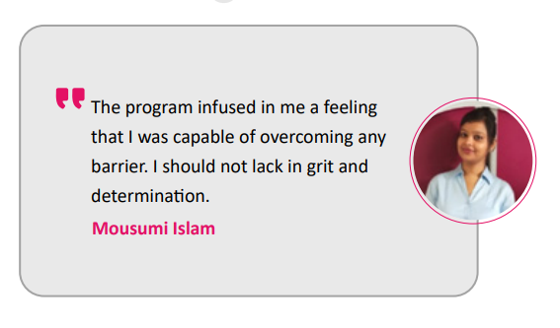
Youth Employment Program – Impact
ECONOMIC IMPACT
1.5X
Enhancement in income in comparison to male employee in a rural area
2.3X
Enhancement in income in income in comparison to a female employee in a rural areas
4X
Enhancement in income for SC/ST/OBC in comparison to elementary occupations
SOCIAL IMPACT
74%
indicated an enhancement of status in the family and community
91%
indicated enhanced self-esteem and confidence
81%
Indicated that better jobs led to a change of role as earning member

Slide 9
Thank you

