Slide 1
by Dr. Bashir Ahmad Shairgojray Assistant Professor Department of Chemistry Govt Degree College Kulgam
Presentation
On
INFRARED SPECTROSCOPY

Slide 2
Contents
What is Infrared Spectroscopy?
Process involved in IR
Uses and Application
Advantages
Disadvantages
Conclusion

Slide 3
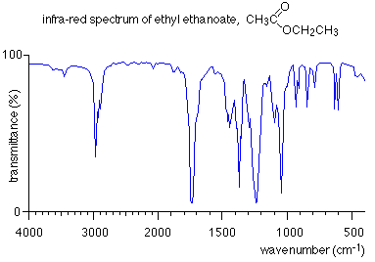
What is Infrared Spectroscopy?
Is the spectroscopy that deals with the infrared region of the electromagnetic spectrum, that is light with a longer wavelength and lower frequency than visible light.

Slide 4
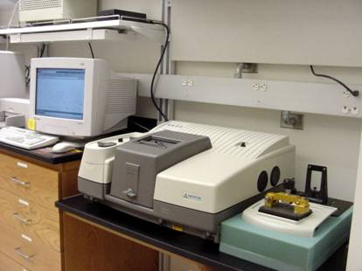
Infrared Spectrometer
Infrared Spectrometer determines the wavelength and absorbance of a sample in the infrared region of the electromagnetic spectrum.

Slide 5
IR Frequency Range of
Functional Groups
Different groups absorb at different wavelengths--characteristic frequencies. Carbonyl groups absorb at certain frequencies, primary amines at others, phenyl groups at still others, and so on.
Functional Group | Frequency (cm-1) | intensity
water OH Stretch | 3700-3100 | strong
N-H stretch | 3500-3350 | strong
stretch | ~2250 | strong
C=O aldehyde | 1740-1720 | strong
C=O ester | 1750-1720 | strong
C=O ketone | 1745-1715 | strong
C=O amide | 1700-1500 | strong
C=C alkene | 1680-1600 | weak
C=C aromatic | 1600-1400 | weak
C-F | 1400-1000 | strong
C-Cl | 800-600 | strong
C-Br | 750-500 | strong
C-I | ~500 | strong

Slide 6
The IR Spectroscopic Process
The quantum mechanical energy levels observed in IR spectroscopy are those of molecular vibration
We perceive this vibration as heat
When we say a covalent bond between two atoms is of a certain length, we are citing an average because the bond behaves as if it were a vibrating spring connecting the two atoms
For a simple diatomic molecule, this model is easy to visualize:

Slide 7
There are two types of bond vibration:
Stretch – Vibration or oscillation along the line of the bond
Bend – Vibration or oscillation not along the line of the bond
H
C
H
C
H
H
symmetric
asymmetric
H
H
H
H
C
C
C
C
C
C
C
C
H
H
H
H
scissor
rock
twist
wag

Slide 8
As a covalent bond oscillates – due to the oscillation of the dipole of the molecule – a varying electromagnetic field is produced.
The greater the dipole moment change through the vibration, the more intense the EM field that is generated.

Slide 9
Uses and Applications
It is also used in forensic analysis in both criminal and civil cases, for example in identifying polymer degradation.
Chemical Analysis: Testing Pill Quality. According to "Medical News Today," scientists at the University of Maryland have been successful in using the method of near-infrared spectroscopy (NIR) to make a prediction regarding quick dissolution of pills inside the body. The success of the experiment can help drug manufacturers in checking the quality of pills to benefit consumers in the health industry.

Slide 10
Chemistry Applications: Using infrared spectroscopy, it is possible to measure the degree of polymerization in chemical compounds. Polymerization happens when monomer molecules undergo chemical reaction to form polymer chains. Infrared spectroscopy can measure the changes in the nature and quantity of molecular bonds. Portable instruments that can measure infrared spectroscopy are used in field trials. This method is important for researchers in identifying more uses of different substances to improve the lives of modern society. Medical breakthroughs are not far behind. The analysis of molecular compounds can lead to the discovery of new chemical compounds that can produce useful products.

Slide 11
It's cheap and fast compared to things like NMR.
It also works for a wide variety of samples and can detect things very strongly, whereas similar techniques like raman spectroscopy are weaker.
Advantages

Slide 12
Disadvantages
Sample preparation is time consuming and that it can't give information as detailed as other techniques such as NMR.
It's also a destructive analysis method and therefore precious or scarce sample should be analysed by a non-destructive method such as raman.
It's also qualitative rather than quantitative and there are a lot of compounds which are not IR active and therefore can't be detected.

Slide 13
Conclusion
IR identifies the components of a sample (liquid, solid or gas).
Infrared (IR) spectrometers measure the interaction of IR radiation with samples. The FTIR spectrometer measures the frequencies at which the samples absorb the radiation, and the intensities of the absorptions.
Intensity and frequency of samples absorption are depicted in a two-dimensional plot called a spectrum. Intensity is generally reported in terms of absorbance - the amount of light absorbed by a sample, or percent transmittance – i.e. the amount of light, which passes through it.
What makes up an unknown sample, and how much of each component is present in that sample, can be valuable information supplied by this technique. Its many applications include research and development of new products.

Slide 14
Thank You

